Slide 1
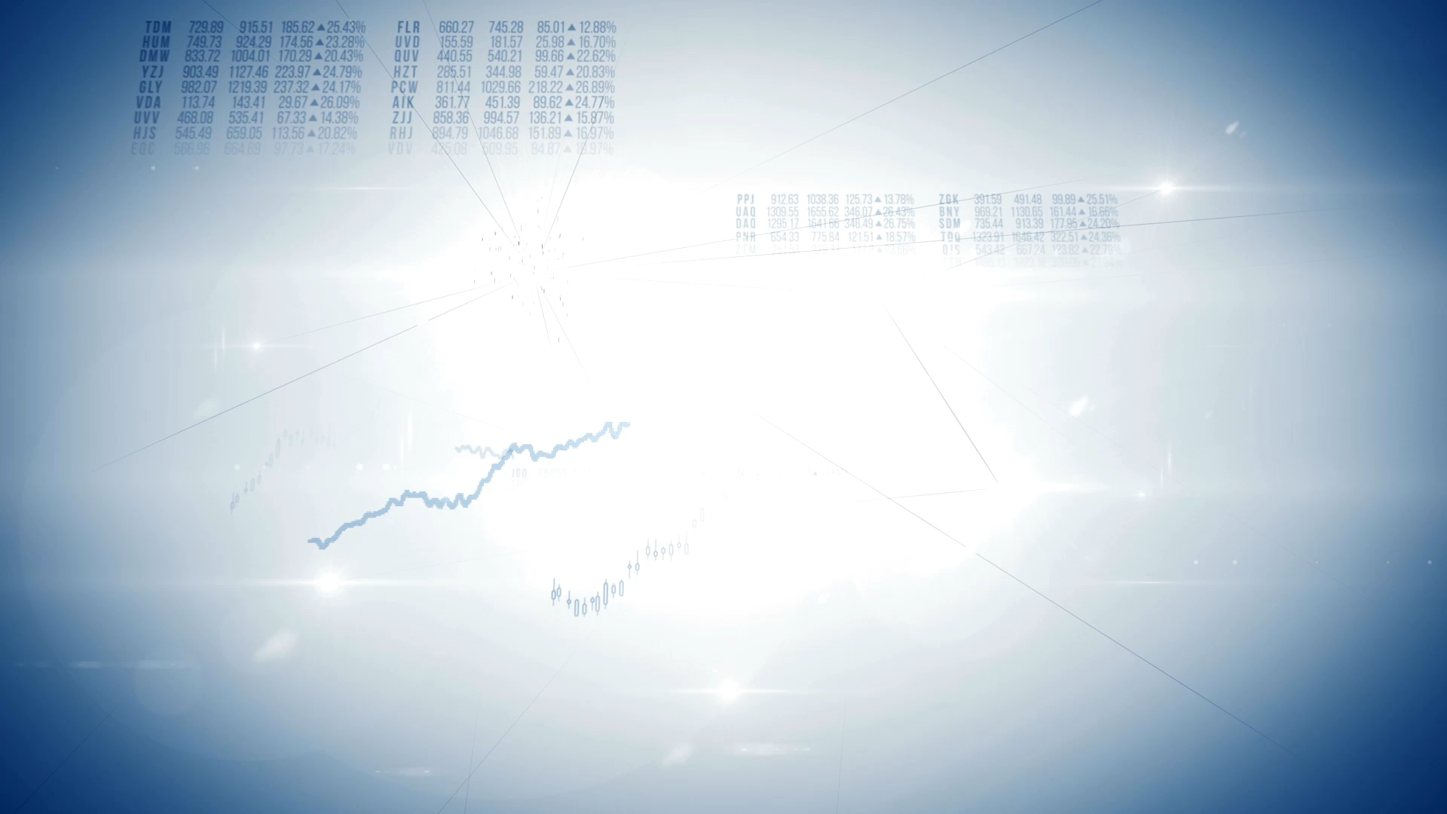
Graph Analyser
Xtai Lab
Notes:
Today we’re going to present the result of the project which we developed
for me as XtAI lab 2 and for Maryam as lab 1

Slide 2

Agenda
Backend – Mamad 🙋🏻‍♂️
Frontend – Maryam 🙋🏻‍♀️
Notes:
Because we

Slide 3

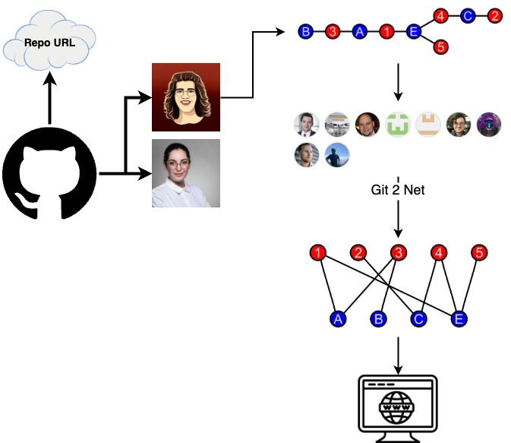
What is it even about?
Graphs from Repos
Notes:
We were working in somewhere between github repos and complex networks
As you can see we developed here in between an app which receives from git repo a complex netwrok
Anaysize and make it clean using git2net
And finally shows it to the end users

Slide 4

BACK-end
Notes:
Now I wanna talk in more detail about the backend part of the app
Project Management: Oversaw the project timeline, ensuring milestones were achieved.
Library Mastery
Learned and implemented git2net, pathpy, and NetworkX for data pre-processing, calculations, and analytics.
Data Analysis
Offered insights and intuitions into the collaboration network of a Git repository.
System Architecture
Took charge of designing the system's overall structure.
API Setup
Established the API endpoints using Flask.
Backend Development
Focused on clean, maintainable coding practices for backend implementation.
Single Responsibility Principle (SRP) Application: Ensured that each class/module had only one job, enhancing maintainability and scalability.
Documentation
Wrote a README file, provided inline code comments, and ensured overall code readability.
System Visualization: Produced UML diagrams to represent system architecture.

Slide 5

backend Core tools
Flask
Git2net
NetworkX
Notes:
These are the main tools which have been used in backend side

Slide 6

Notes:
Flask
Because at the end we wanted to user git2net and it’s Python based
To reduce compexity of component integrations I decided to use a Python based framework

Slide 7
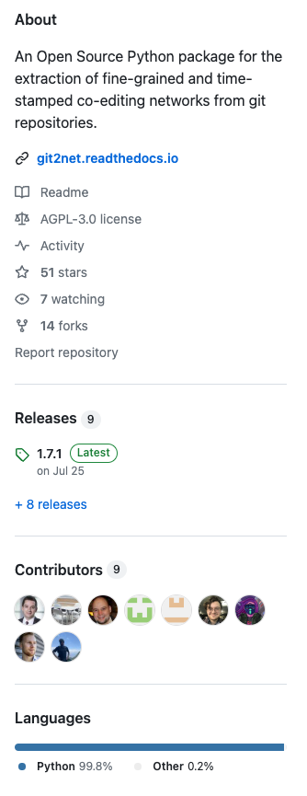

git2net
Notes:
Git2net
It’s the core library which we used to analyse the git repo as well as the network

Slide 8
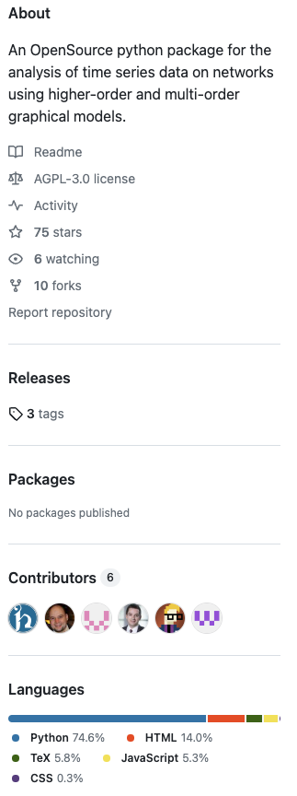

Pathpy

Slide 9
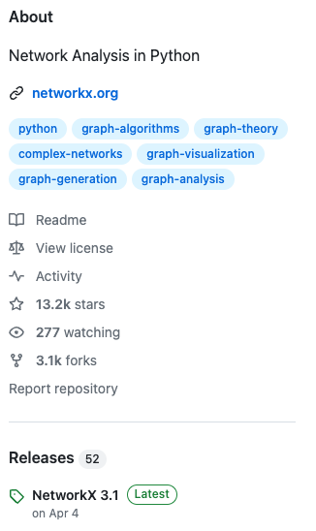

Networkx
Notes:
NetworkX
In addition to the analyse and visualization the app can show useful measurements like degree of centrality
Which the calculation are being done using NetworkX

Slide 10
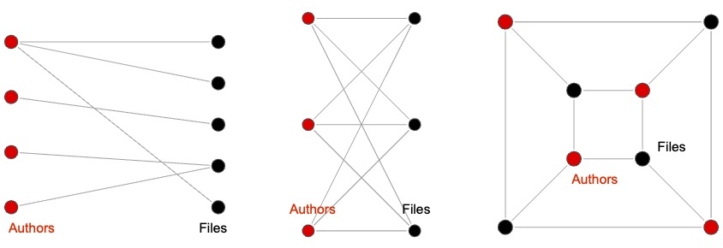
Bipartite graphs
Notes:
Before we know more about the app it’s required to know what is Bipartite graphs
Graphs which edges can be divided to 2 groups
All edges connects sets together not edges of the same set

Slide 11
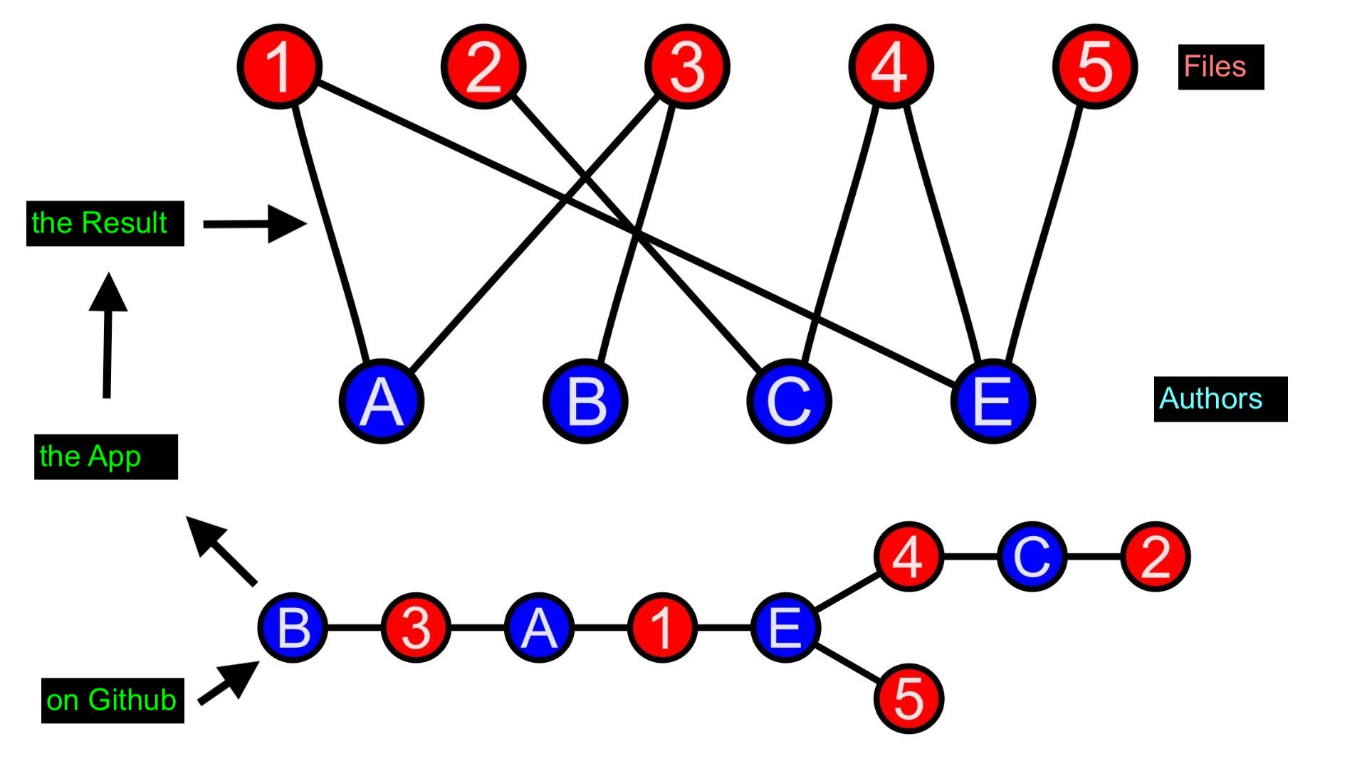
flowchart
Notes:
it’s basic visualization of the app
We receive complex network and unsorted data structre
Feed to the app
As a result we can have organized data structure and user-friendly bipartate network to show
In 1 side authors and another side files

Slide 12

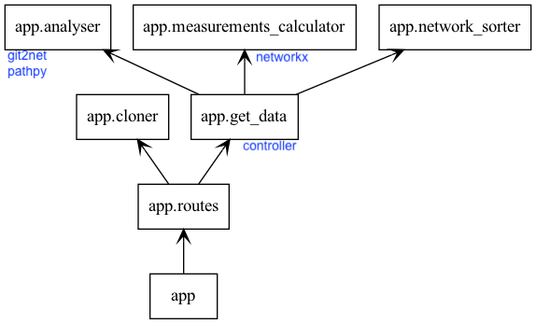
backend architecture
SRP, Clean Architecture and Open for Extension(Future Work)
Notes:
Here is the arch of the backend
Because we’re in the university and it was a scientific project and I thought I should think of future work
and the future students which gonna develop firther this app
As you can see I tried to stick to the best practices like CA and SRP to make it easier for future development or maintanance

Slide 13
Front-end

Slide 14
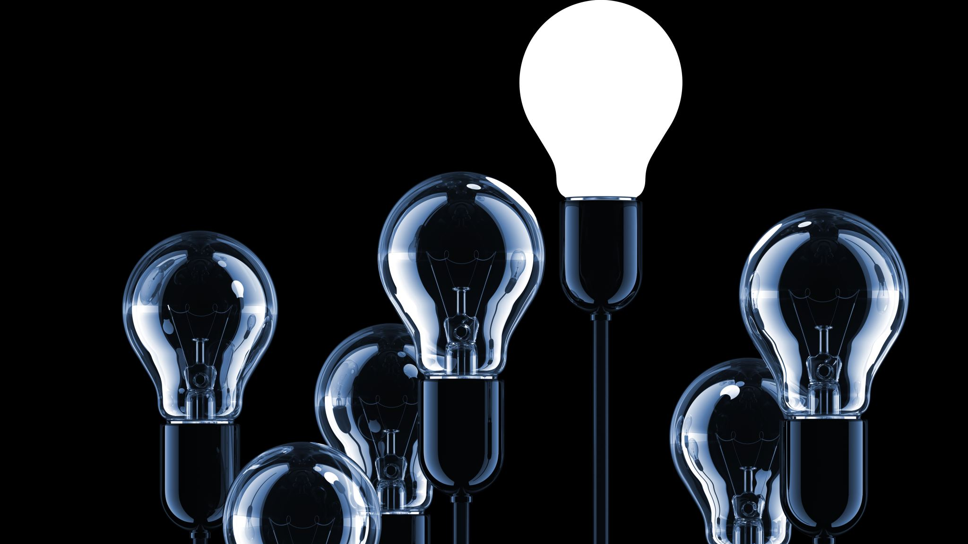
Thanks for your attention!

